Slide 1
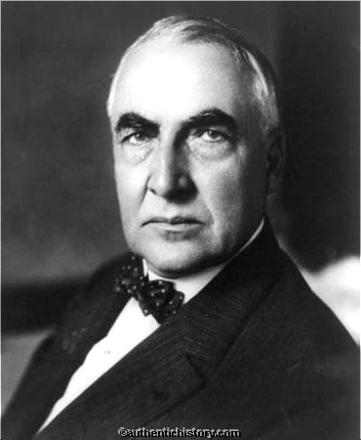
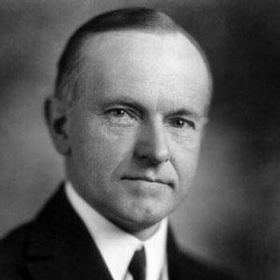
Chapter 16 Presidential Politics

Slide 2
Harding Administration 1921-1923
Supported Laissez-Faire Policies towards Business
Wanted to return a “Return to Normalcy” = more isolationism with his foreign policy & greater emphasis on peacetime production and prosperity
Refused to join the league of nations
Enacted high tariffs
Lowered taxes
Restricted immigration

Slide 3
Problems
Ohio gang – Harding's old poker/childhood friends that he put into High ranking cabinet positions
Teapot Dome Scandal – Secretary of the Interior, Albert Fall, secretly leased oil-rich government lands at Teapot Dome WY to 2 business friends in exchange for personal bribes
Charles Forbes – stole millions from construction of hospitals for returning veterans

Slide 4
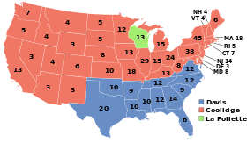
1924 Election Results

Slide 5
Calvin Coolidge 1923-1928
Known as Silent Cal
Wanted little Govt. interference in the Economy

Slide 6
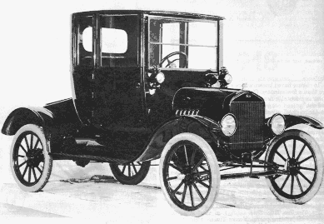
16.2: A Growing Economy
People wanted cars more than indoor plumbing
Henry Ford – engineer & automobile manufacturer
Created the Model T in 1905 (1st car middle class people could buy)
Created commuters / small businesses

Slide 7
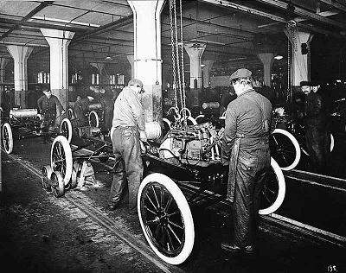
Ford created the Assembly Line in 1914, increased production by moving cars along a conveyor belt (1.6 million a year)
Average price was less than $300
1925 1 car was produced every 10 seconds

Slide 8
New Technology
Improved Motors
Trans-Atlantic Telephone service
Vacuum Cleaner (yes☺)
Refrigerator
Toaster
Radio & Motion Pictures
Auto Industry also helped in areas like (Rubber, plate glass, nickel, lead)

Slide 9
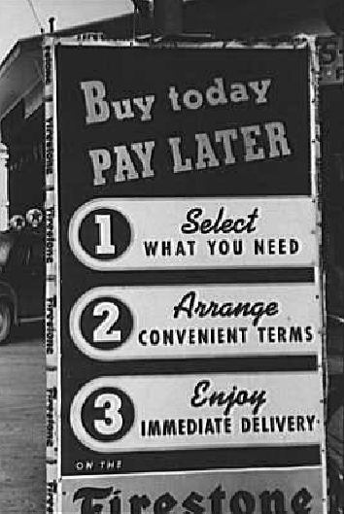
Consumer Credit
Advertising stimulated demand for products
Businesses developed new programs called “Installment Programs” = buyer makes a small down payment then pays the rest in small monthly payments so this is called DEBT

Slide 10
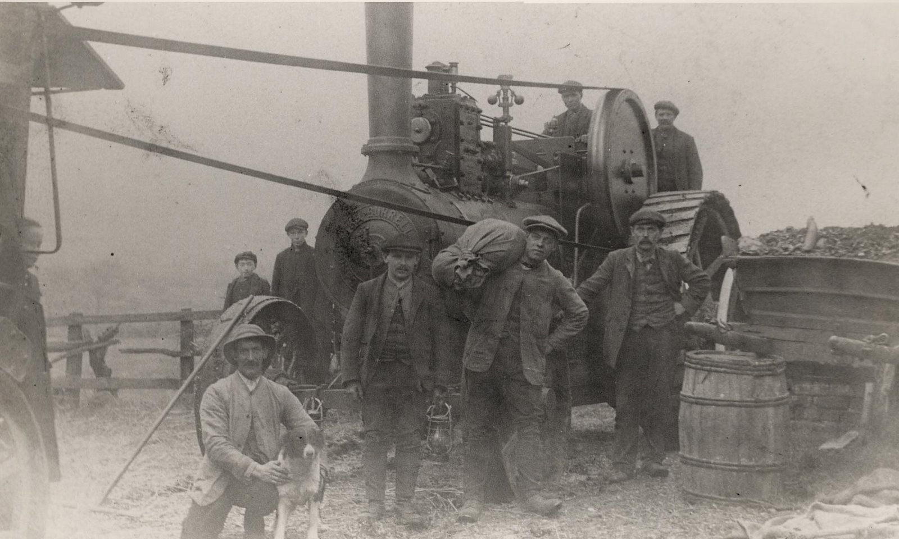
Farm Crisis / Depression
WW 1 Farmers prospered a lot due to new technology in: fertilizers, pesticides, seeds, and farm machines
Big demand for food but after the war the process of food dropped heavily
Many farmers bought these items on credit ☹

Slide 11
16.3: Prosperity Booms
Andrew Melon (Sec. of Treasury) b/v in applying business principles to its operations
1. Balance the Budget
2. Reduce Govt. Debt
3. Cut taxes
By doing these 3 things Supply Side Economics would occur – Americans would earn more money, the govt. would actually collect more taxes at lower rates

Slide 12
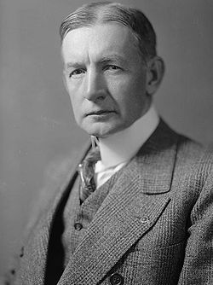
Trade & Arms Control
Before WW 1 U.S. was indebt to other countries
After, Europe was in debt to America(Economic Power House)
Isolationism – U.S. wanted to be left alone to pursue economic prosperity
Europe was mad at America b/c of their high tariffs and were having a hard time selling their products and paying off their debts to America
Charles G Dawes – An American Banker = Dawes Plan to help this debt problem out

Slide 14
The Washington Conference, November 1921-February 1922
Treaty | Signers | Terms | Weaknesses
4 Power Treaty | U.S., Great Britain, France, Japan | All agreed to respect the others territories in Pacific Full & open negotiations in the event of disagreements | Mutual defense of other co-signers not specified
5 Power Treaty | U.S., Great Britain, France, Japan, Italy | All agreed to freeze naval production at 1921 levels & halt production of large warships for 10 yrs U.S. Great Britain would not build new naval bases in the western pacific | No restrictions on the construction of smaller battle craft such as submarines & naval destroyers Did not place restrictions on the ground forces
9 power treaty | U.S., Great Britain, France, Japan, Italy, Belgium, China, Netherlands, Portugal | All agreed to preserve equal commercial rights to China a reassertion of the open door policy. | No enforcement of the terms of the “Open Door Policy” specified.

Slide 15
Preventing War?
Secretary of State Frank Kellogg came up with this pact below:
Kellogg-Briand Pact – August 1928 the U.S. and 14 other nations signed this pact hoping
- All signers agreed to abandon war & to settle all disputes by PEACEFUL means

