Slide 1
Chapter 10: “Launching of the New Ship of State” ~ 1789 – 1800 ~

Slide 2
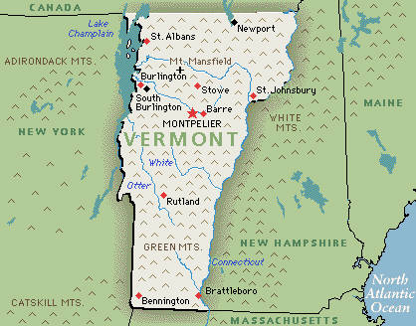
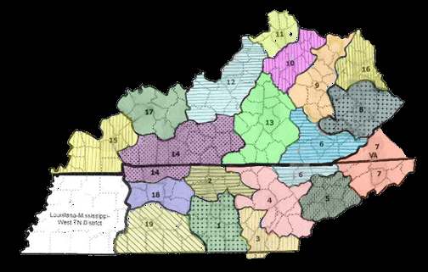
A New Ship on an Uncertain Sea
In 1789, the new U.S. Constitution was launched, and population was doubling every 25 years.
America’s population was still 90% rural, with 5% west of the Appalachians.
Vermont became the 14th state in 1791, and Kentucky, Tennessee, and Ohio soon followed.

Slide 3
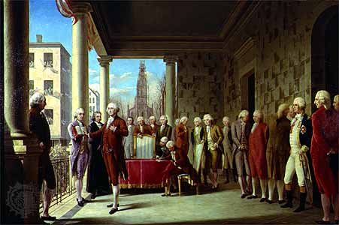
Washington

Slide 4
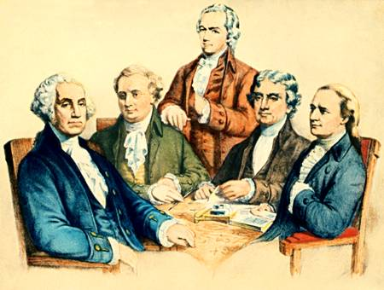
Washington’s Profederalist Regime
Washington established a diverse cabinet (which was not necessary, Constitution-wise).
Secretary of State: Thomas Jefferson
Secretary of the Treasury: Alexander Hamilton
Secretary of War: Henry Knox

Slide 5
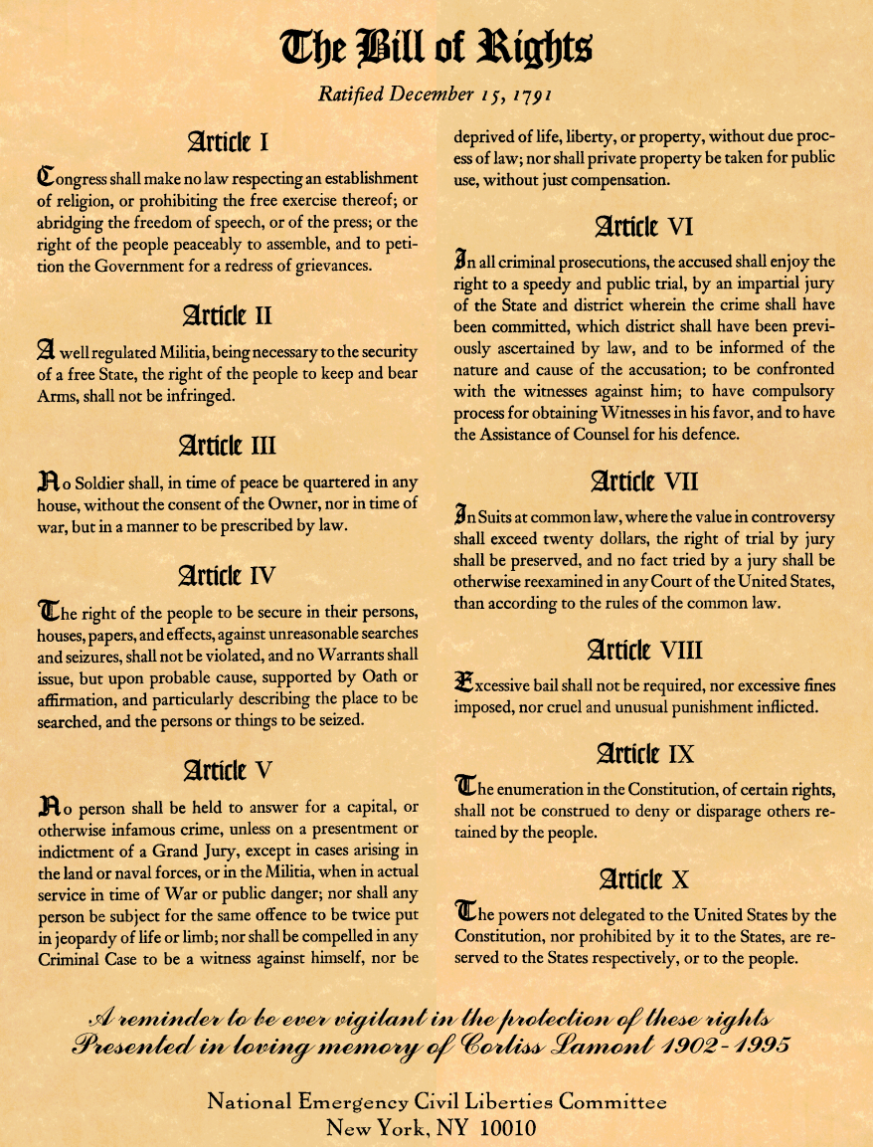
The Bill of Rights
Many states had ratified the Constitution on the condition that there would be a Bill of Rights, and many antifederalists had criticized the Constitution for its lack of a Bill.

Slide 6
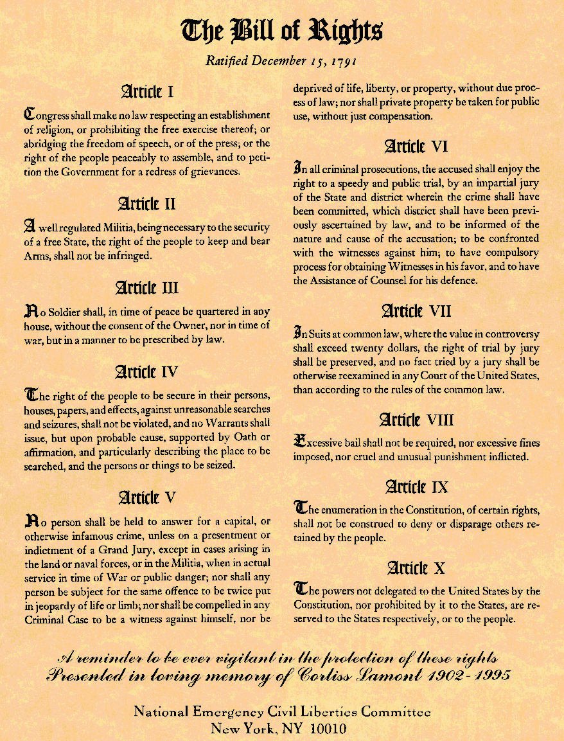
The Bill of Rights
The necessary number of states adopted it in 1791.
Amendment I: Freedom of religion, speech or press, assembly, and petition.
Amendment II: Right to bear arms (for militia).
Amendment III: Soldiers can’t be housed in civilian homes during peacetime.
Amendment IV: No unreasonable searches; all searches require warrants.
Amendment V: Right to refuse to speak during a civil trial; Double Jeopardy.
Amendment VI: Right to a speedy and public trial.
Amendment VII: Right to trial by jury when the sum exceeds $20.
Amendment VIII: No excessive bails and/or fines.
Amendment IX: Other rights not enumerated are also in effect.
Amendment X: Non-federal powers belong to the state.

Slide 7
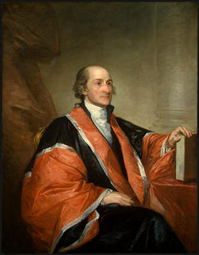
John Jay

Slide 8
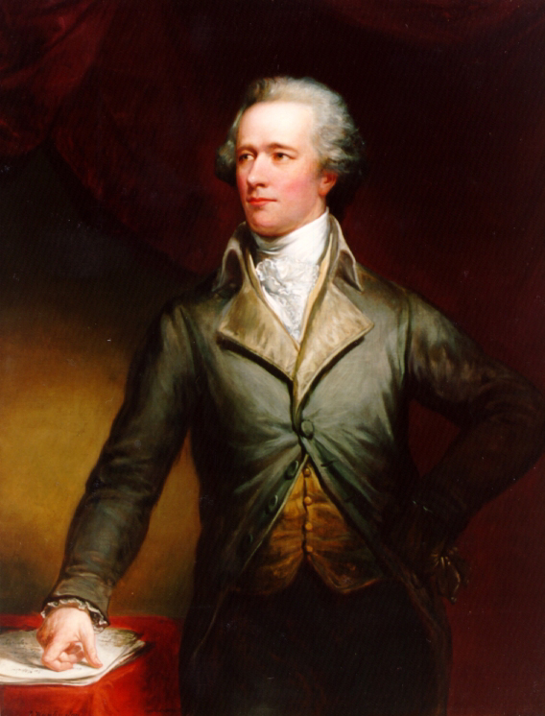
Alexander Hamilton

Slide 9
Hamilton Revives the Corpse of Public Credit
Asked Congress to pay the national debt and states debt
Massachusetts vs. Virginia ….
Wanted the rich to have a stake in the government…
Believed national debt was a blessing…

Slide 10
Tariffs and Excise Taxes.
Tariffs …
Excise Taxes…
7 cent/gallon tax on Whiskey

Slide 11
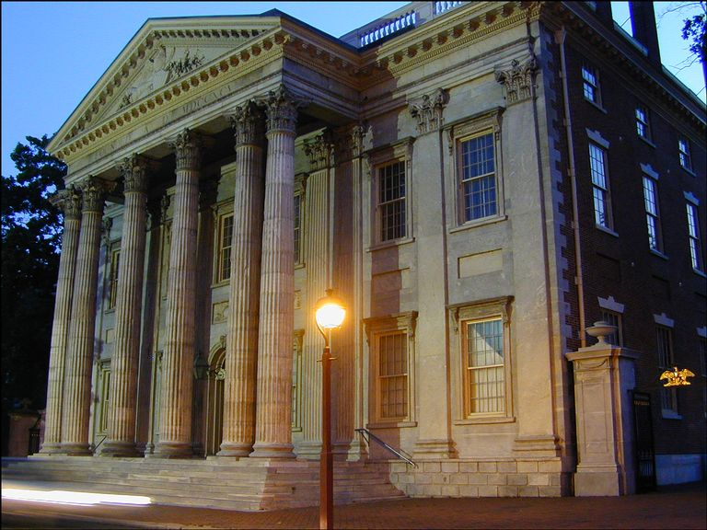
Hamilton Proposes a Bank of the United States
Powerful Bank backed by the government would stimulate business and print money creating a stable currency…

Slide 12
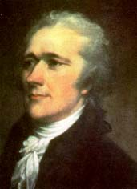
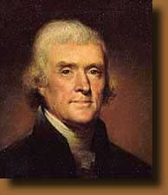
Hamilton Battles Jefferson for a Bank
Hamilton’s Views:
What was not forbidden in the Constitution was permitted.
A bank was “necessary and proper” (from Constitution).
He evolved the Elastic Clause.
Jefferson’s Views:
What was not permitted was forbidden.
A bank should be a state controlled item (9th Amendment).
The Constitution should be interpreted literally and strictly.

Slide 13
Hamilton Wins the Argument – Washington reluctantly creates the Bank of the United States (20 year charter)

Slide 14
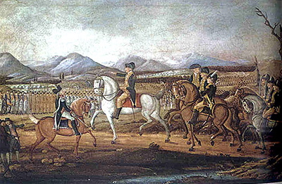
Whiskey Rebellion

Slide 15
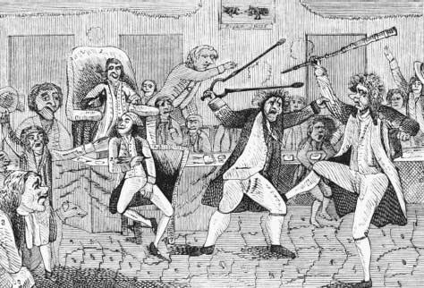
The Emergence of Political Parties
Resentment from Hamilton’s policies …
The Founding Fathers had not envisioned various political parties …
The beginnings of the two –party system…

Slide 16
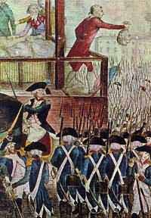
The Impact of the French Revolution
Initially very supportive until…
The Reign of Terror…
Conflict spreads to the New World…

Slide 17
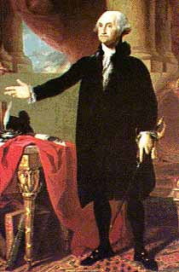
Washington’s Neutrality Proclamation
Jeffersonian Democratic-Republicans wanted to…
However, Washington knew that war could mean disaster and disintegration…

Slide 18
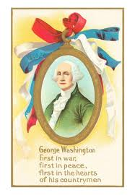
Washington’s Neutrality Proclamation
Did not consult congress – enraging Jeffersonians
Officially proclaimed neutrality
Created a tradition of isolationist policies…

Slide 19
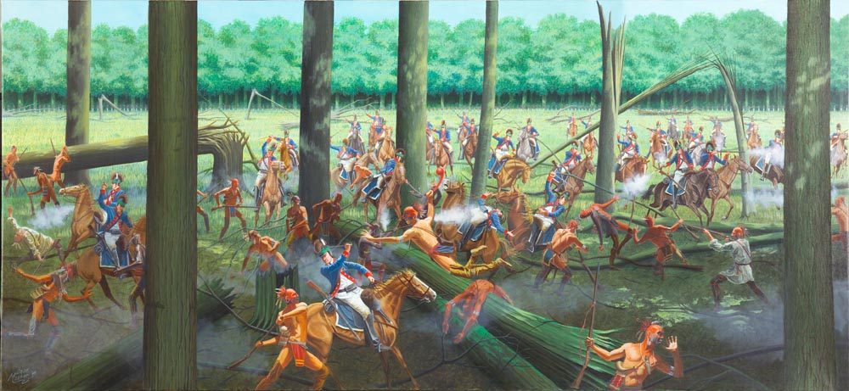
Miami Confederacy defeated at the Battle of the Fallen Timbers
“Mad” Anthony Wayne
Treaty of Grenville …

Slide 20
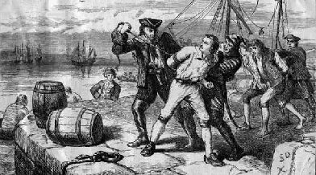
Embroilments with Britain

Slide 21
Jay’s Treaty
In a last-ditch attempt to avert war Washington sent John Jay to England to work something out.
However, his negotiations were sabotaged by Hamilton, who secretly gave the Brits the details of America’s bargaining strategy.
The results weren’t pretty:
Britain would repay the lost money from recent merchant ship seizures, but it said nothing about future seizures, impressments, and Indians arms supplying.
America would have to pay off its pre-Revolutionary War debts to Britain.

Slide 22
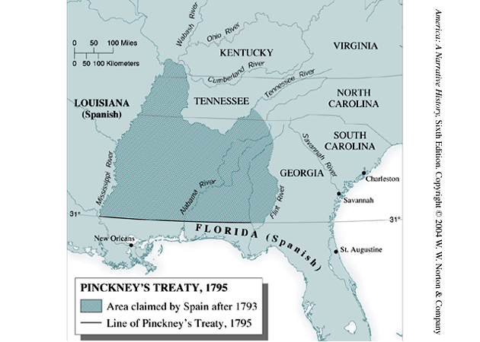
Pinckney’s Treaty

Slide 23
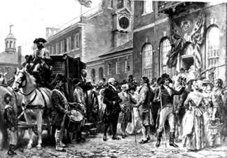
Washington’s Farewell Address
Warned against “permanent alliances”

Slide 24
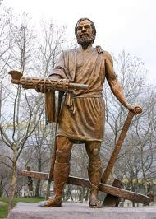
Washington = Cincinattus
Set a precedent for presidents to serve only two terms…
George III…

Slide 25
John Adams 2nd President
Campaign focused on personalities…
John Adams, the ablest statesmen of his day, won, 71 to 68, against Thomas Jefferson, who became vice president.

Slide 26
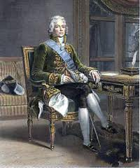
Talleyrand and the XYZ Affair
French agents (X,Y, & Z) demanded bribes from an American diplomatic commission…
Created a war hysteria in the U.S.
“Millions for defense, but not one penny for tribute”
French Prime Minister Talleyrand backs down…

Slide 28
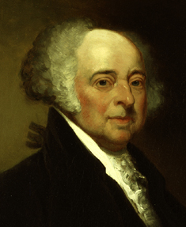
Adams Puts Patriotism Above Party
Convention of 1800 ended the 1778 alliance in return for the American paying of the claims of its shippers as alimony.
Adams preserves peace at the price of popularity.

Slide 29
Alien and Sedition Acts
Designed to limit opposition to the Federalists…
Alien Law…
Sedition Acts…

Slide 30
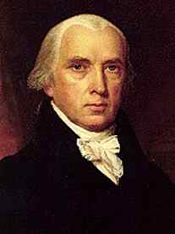
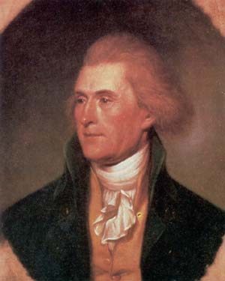
The Virginia (Madison) and Kentucky (Jefferson) Resolutions

Slide 32
Federalists
Rule by the “best people”…
Wanted a strong central govt…
Pro-British (Hamilton’s Trade Policies)
Loose interpretation of the Constitution…
Pro-Bank of U.S.
Pro-National Debt
Some restrictions on speech and press…

Slide 33
Democratic - Republicans
Small farmers, laborers the “common man”…
Wanted a weak central govt…
Pro-French…
Strict interpretation of the Constitution…
Anti-National Debt…
Anti-Bank of the U.S.
Free speech and free press

Slide 34
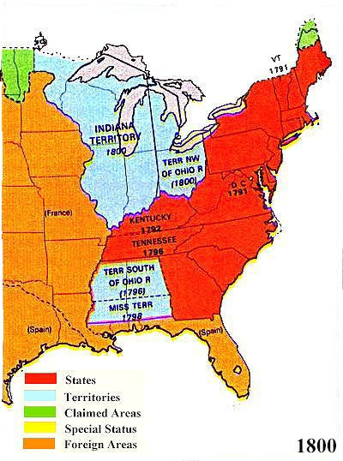
1800: One Nation, United?

