Slide 1
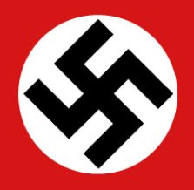
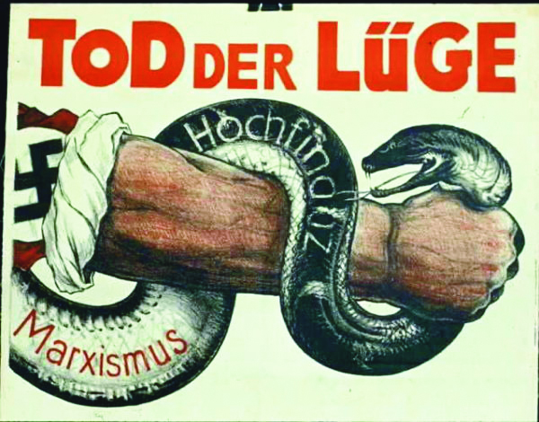
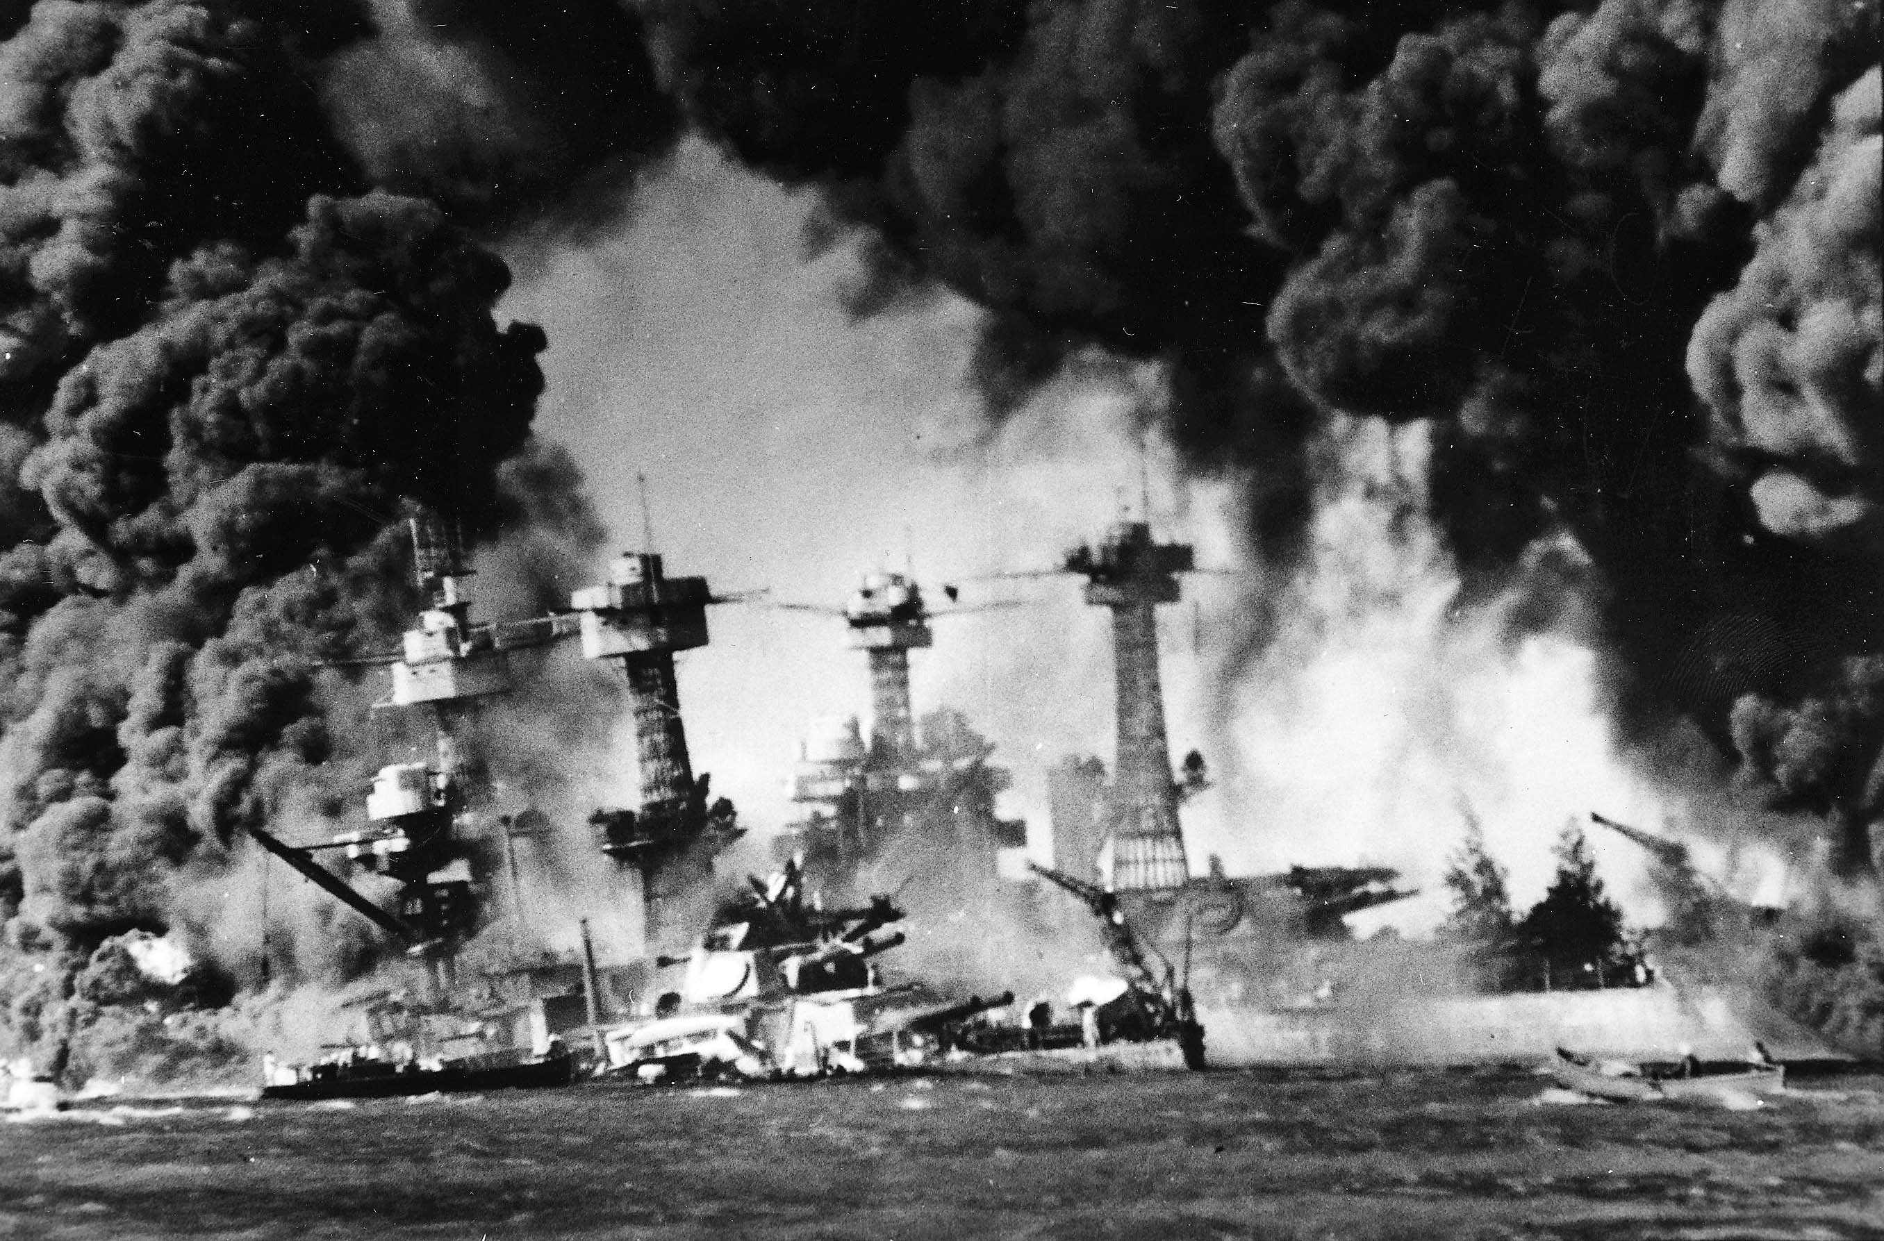
A World in flames 1920-1941

Slide 2
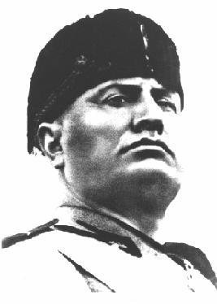
America in the world – rise of dictators
Benito Mussolini – Fascists Dictator of Italy
Fascists b/v in putting the country above the individual (Extreme Nationalism)
Greatness – expand your territory and build up your military

Slide 3
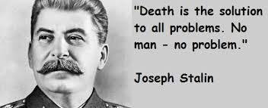
Bolshevik Revolution in 1917 Vladimir Lenin took over
The USSR became Communists
Joseph Stalin tool over in 1926 & became the new dictator
Wanted to Industrialize the Country
Tolerated NO oppositions
Killed 8-10 million of his own people who stood in his way

Slide 4
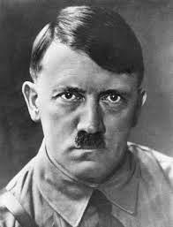
Adolf Hitler – was anti-communist
Fought in WW 1
Hated the German Govt. for agreeing
to the treaty of Versailles
He joined the Nazi Party (nationalistic and anticommunist)
Nov. 1923 Hitler tried to seize power, but failed in was arrested
In prison he Wrote “Mein Kampf” = My Struggle
Called for Govt. Reunification
B/v strongly in the Aryan race (Blond Hair & Blue Eyes)
Wanted to expand into Poland & Russia (Living Space)
B/v that Jews were responsible for most of the World's problems and the loss in WW 1

Slide 5
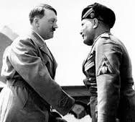
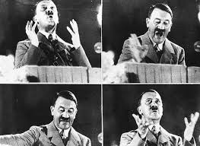
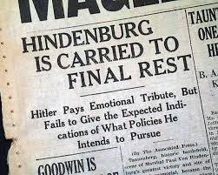
Hitler Joined the lower parliament house in 1932
1933 the German president appointed Hitler as chancellor(prime minister)
Hitler then becomes Fuhrer (leader) of all Germany

Slide 6
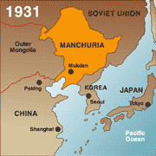
Japan
In the 1920’s Japan did not earn enough money from its exports to pay for its imports (This limited its economic growth & increased unemployment)
Our high Tariff made this even worse
Undemocratic / corrupt politicians
Destined to rule all of SE Asia
To Get resources they would have to seize territory so . . . . .
Invaded Manchuria in N China Sep 1931 (Military did this without Govt approval)

Slide 7
America Turns to Neutrality
America will turn to Isolationism
By 1934 all Nations no longer pay war debts
Nye Committee – Reason why America got involved in WW1 (for huge profits arms factories made) Business reasons
Neutrality Act 1935 – Made it illegal to sale any arms weapons to countries who were at war
After the Spanish Civil War 1936 Hitler and Mussolini signed an agreement pledging to cooperate on international issues called the Rome-Berlin Axis
The following month Japan aligned itself with Germany, Italy (The Anti-Communist Pact) AKA the Axis Powers

Slide 8
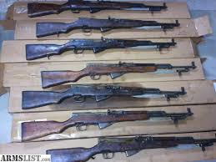
Neutrality Act of 1937 – ban the selling of arms to nations at war, but also required warring nations to buy non military supplies from the U.S. on a “Cash & Carry basis”
It had to send its own ships to pick up the goods, and had to pay cash (Remember WW 1?)

Slide 9
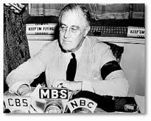
Roosevelt & internationalism
Ending the Depression is the first priority but . . He was NOT an isolationist
FDR was an internationalist – trade between nations creates prosperity & helps prevent war (strive for peace)
1937 Japanese launched a full scale attack on China
FDR – deciding neither country had officially declared war – decided to sale weapons to China
“ War is a contagion, whether it be declared or undeclared . . . There is no escape through mere isolation or neutrality”
Quoted from Freedom of Fear :FDR

Slide 10
WW II Begins
Feb 1937-1938 Hitler invades and takes over Austria and wants part of Czechoslovakia
Munich Conference – Sep 1938: (agreed to Hitler’s demands of wanting the Sudetenland)
This became known as Appeasement
British Prime Minister (Neville Chamberlin) went home . . . Said Hitler can’t be trusted started building up their military (rearming themselves for war)

Slide 12
October 1938 Hitler wanted back Danzig a Baltic Sea Port with Strong German Roots, also wanted highway and railway access to the Polish Corridor
This move right here convinced the British & the French Appeasement had FAILED
March 31, 1939 Britain said that if Germany invaded Poland France and Britain would step in to help Poland to defend themselves . . . Hitler decided to Invade Poland
Hitler sent his Foreign Minister to negotiate with the USSR (didn’t want to fight them also)
August 1939 Germany & the USSR signed a Nonaggression Pact (Divide Poland amongst themselves)
Sep 1, 1939 the Invasion of Poland marks the start of WW 2

Slide 13
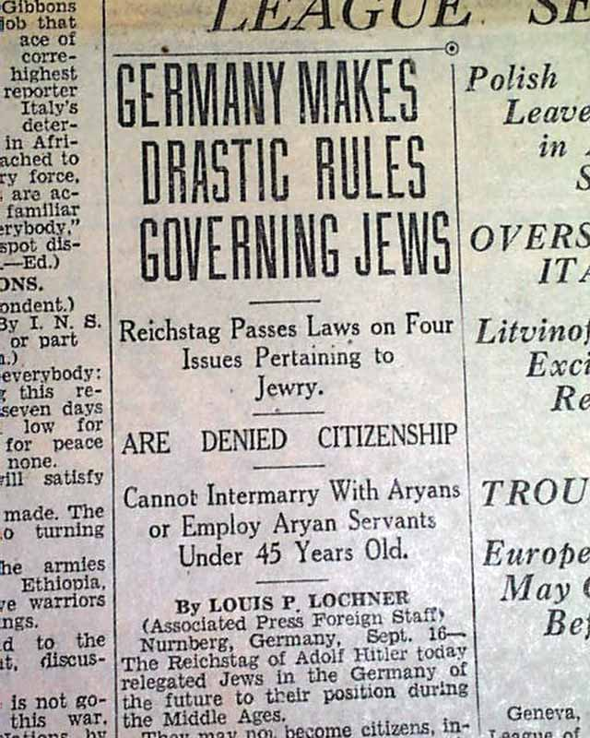
The Holocaust
Means = the “Shoah” catastrophe that ravaged Europe's Jews 6million
Millions of others as well, disabled, Gypsies, homosexuals, Slavic peoples
Sep 1935 Nuremberg Laws (took citizenship away from Jews)
1936 ½ of German Jews were Jobless

Slide 14
Kristallnacht
Nov 7, 1938 – A young Jewish Refugee shot & killed a German diplomat in Paris
In retaliation Hitler ordered (Joseph Goebbels-propaganda minister) to stage attacks a/g the Jews (spontaneous reaction to news of the murder)
Nov 9 this was carried out in a series of destruction
Became known as the night of Broken Glass
By morning, 90 Jews lay dead, 100’s more badly wounded,7,500 businesses were destroyed, 180 synagogues were wrecked
Police & Fire man were told to stand down that night

Slide 15
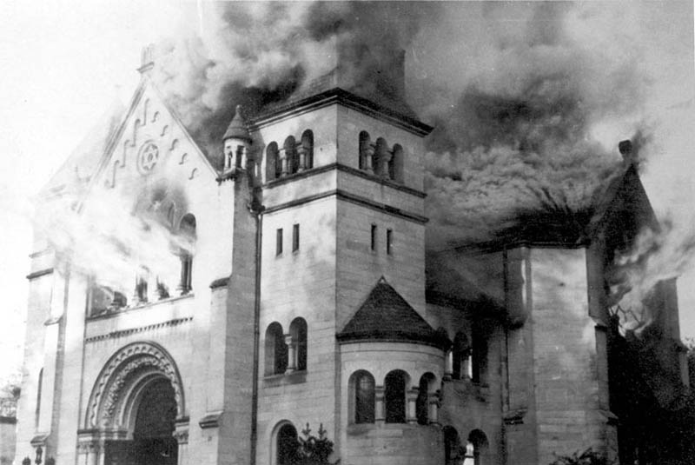
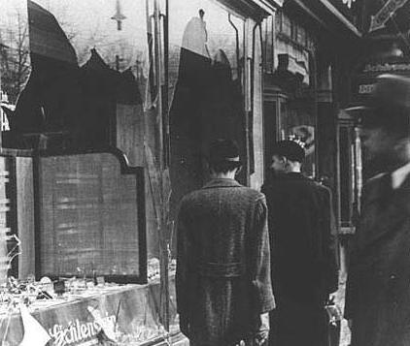

Slide 16
Why was IT hard for the Jews to leave Germany
The next night the Gestapo – German secret police arrested 20,000 of the wealthiest Jews (had to surrender all of their possessions and promise to emigrate to be released)
Government refused to allowed insurance companies to help out the victims
The Jews then had to turn around and pay for all the damage that was done the night before
1939-1939 = over 350, 000 Jews left Germany (Famous Scientist Albert Einstein Princeton NJ, Anne Frank in Amsterdam)
Money
Passports
Quota Systems

Slide 17
Deceiving the Public
Propaganda served as an important tool to win over the majority of the German public who had not supported Adolf Hitler and to push forward the Nazis' radical program
A new state propaganda apparatus, headed by Joseph Goebbels, sought to manipulate and deceive the German population and the outside world
Propagandists preached an appealing message of national unity and a utopian future
An antisemitic poster published in Poland in March 1941. The caption reads, "Jews are lice; They cause typhus." This German-published poster was intended to instill fear of Jews among Christian Poles.

Slide 18
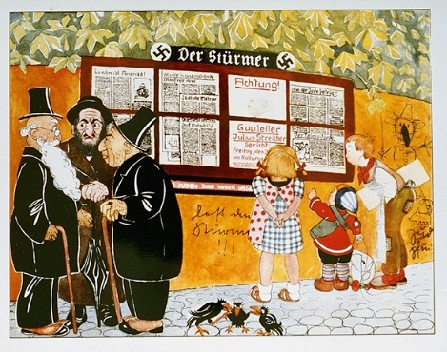
Illustration taken from a Child’s book
Jews are our misfortune and they cheat

Slide 19
“A New People”
Calendar cover,
“A New People 1938,”
Nazi Party Office of Racial Politics
USHMM, source unknown

Slide 20
“The Eternal Jew”
Exhibition poster,
“The Eternal Jew,” Munich, 1937
USHMM, courtesy of Julius Goldstein

Slide 21
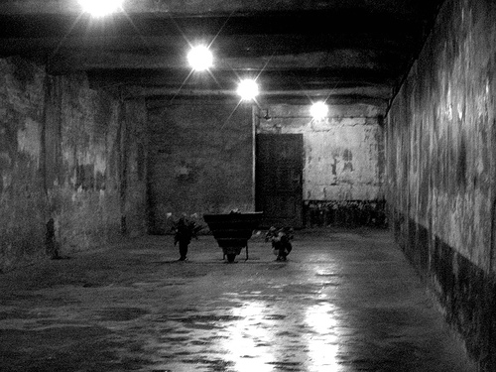
The Final Solution
Jan 20, 1942 Germans gathered at the Wannsee Conference
The Final Solution – What to do with the Jews
Take them to Concentration Camps the healthy would work to death while the sick, elderly, & young children would be sent to death camps to be killed in masses by gas chambers

Slide 22
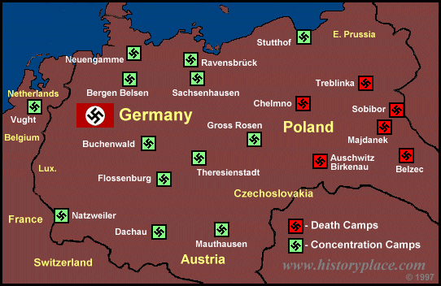

Slide 23
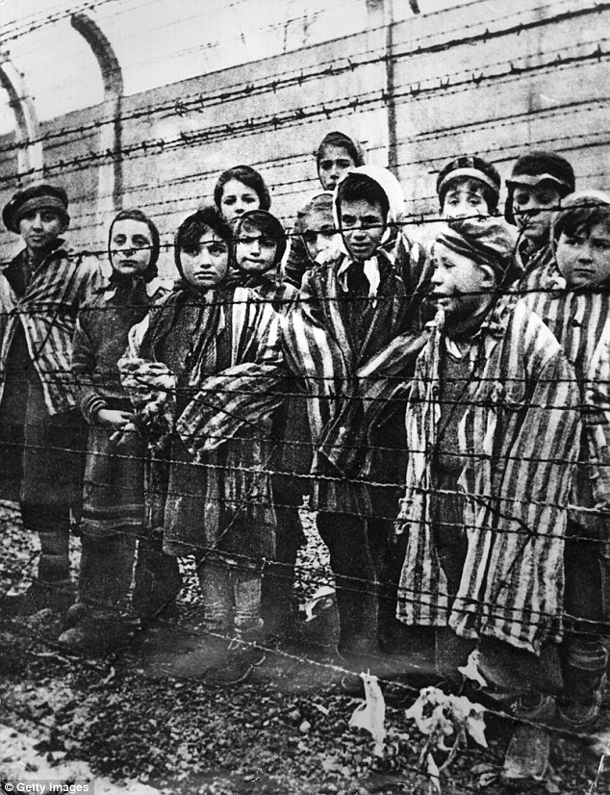
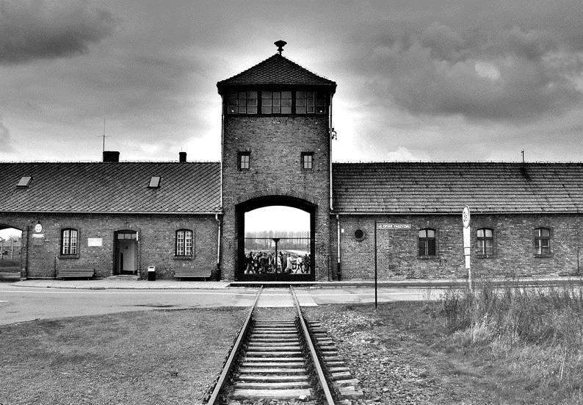
Most camps were In Poland
Auschwitz & Treblinka housed and killed the most Jews
Gas chamber killed 2,000 at 1 time up to 12,000 a day

Slide 24
America Enters the War
FDR declared Neutrality in 1939 right after France & Britain declared war on Germany
FDR wanted the ban on arms sales lifted = so congress agreed to sale arms to other nations on a cash and carry service
Spring 1940 Winston Churchill the NEW Prime Minister of England asked the U.S. for old ship destroyers
Destroyers for bases deal – we would send ships in exchange for bases in British Controlled territories like Bermuda, Newfoundland
America 1st Committee – isolationist group who opposed any American Intervention or aid to the allies (Charles Lindbergh, Phillip Lafollette, Gerald Nye)

Slide 25
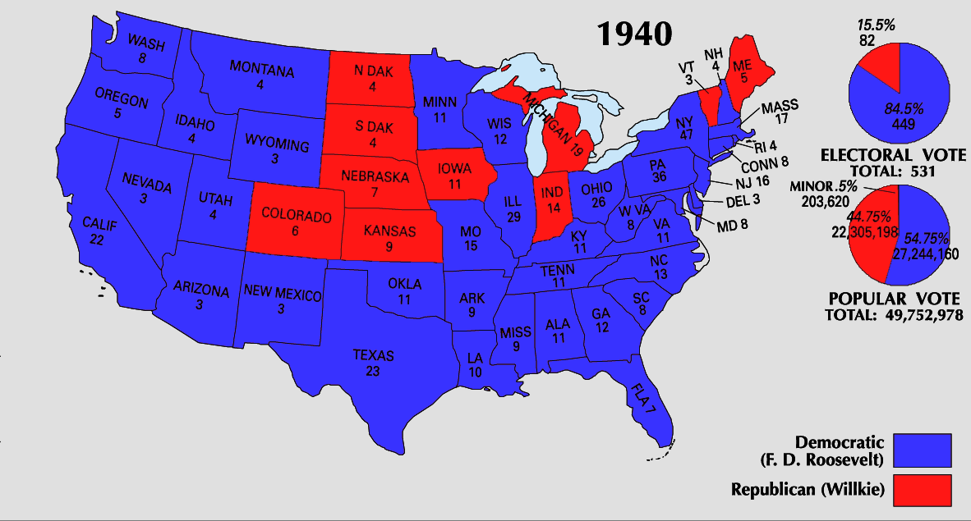

Slide 26
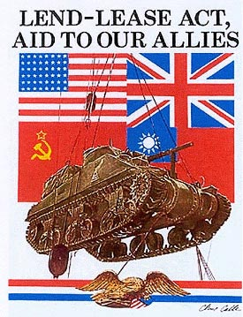
Lend Lease Act – Dec. 1940
America would lend or lease arms to any country considered vital to the defense to the U.S.
Britain was fighting for Democracy we had to help so . . .He FDR listed 4 freedoms to Congress that Britain & America stood for
Freedom of Speech
Freedom of Want
Freedom of Worship
FREEDOM of FEAR

Slide 27
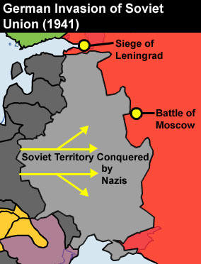
After calling off his invasion Britain Hitler broke the Nazi-Soviet Pact & invaded the Soviet Union
Churchill detested Communism but vowed to help any person or state that would fight against Nazism
Hemisphere defense Zone – West half of the Atlantic was part of the Western Hemisphere so therefore its NEUTRAL . . .then he made the navy patrol the waters to locate German submarines and report back to the British

Slide 29
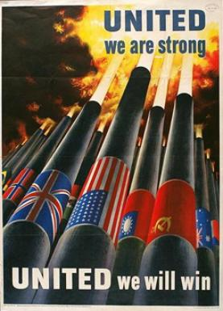
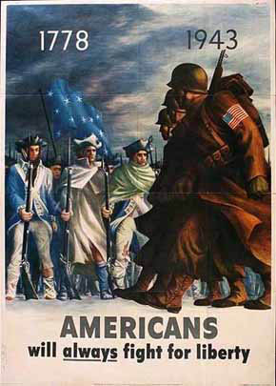

Slide 30
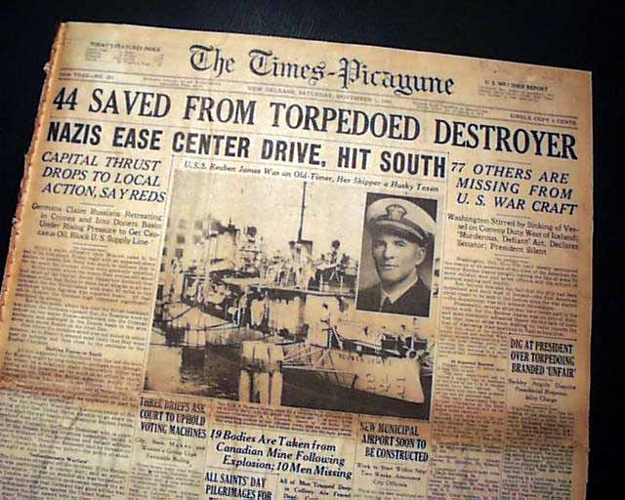
Greer & the Reuben James – American Destroyers who were shot by German submarines
FDR then “shoot on sight” order
Tense Standoff

Slide 31
America Embargos Japan
To help discourage the Japanese from taking over British territory in the Pacific
Japan depended on the U.S. for strategic materials like; scrap iron, steel, especially oil
1940 Congress passed the Export Control Act FDR had the power to restrict strategic materials to other nations
Immediately FDR restricted the sale of airplane fuel and scrap medal to Japan
So . . . Japan rushed to join Italy and Germany (Axis Powers)
By 1941 the Japanese controlled much of the Chinese coast (FDR was hoping the lend lease act would help contain the Japanese – it did not help

Slide 32
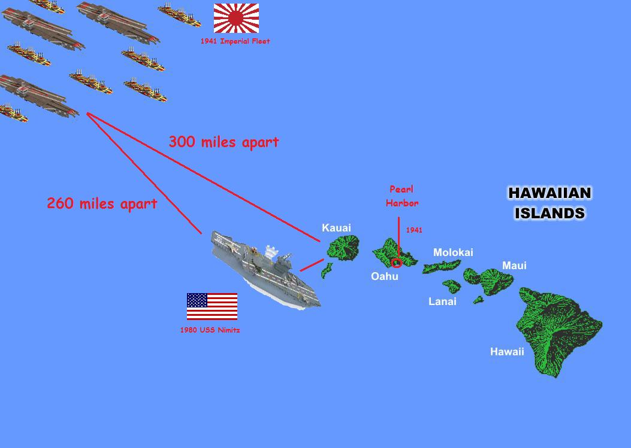
BY July 1941 Japan was getting ready to invade British Indochina
FDR responded by freezing all Japanese assets in America
Reduced the amount of oil being shipped to Japan
Sent General MacArthur to the Philippines to build up American Defenses
Left with no choice the Japanese decided to attack Pearl Harbor December 7, 1941

Slide 33
